Slide 1
PP-OCRv3: More Attempts for the Improvement of
Ultra Lightweight OCR System
Name: Kazi Al Refat Pranta
Student ID: 20101444
Group: 10
ST: Mustakin
RA: Sabbir

Slide 2
INTRODUCTION
Optical character recognition or OCR is the technology where characters printed or handwritten is recognized by the system and converted to digital format for future analysis or processing. It is widely used technology but considering efficiency and accuracy is really critical and important while it is not cloud based or doesn’t meet the system requirement for big models. The authors of the paper tried to present a model that would the exact work of ocr while keeping the accuracy and the speed. In previous work, done by the author, considering the efficiency and accuracy, proposed a practical ultra lightweight OCR system called (PP-OCR), and an optimized version of that called PP-OCRv2. In order to further improve the performance of PP-OCRv2, a more robust OCR system PP-OCRv3 was proposed in this paper. PP-OCRv3 upgrades the text detection model and text recognition model in 9 aspects based on PP-OCRv2.

Slide 3
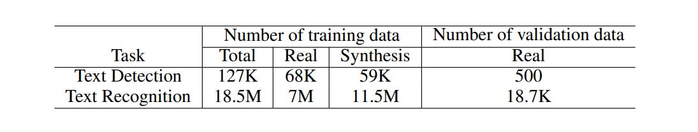
dataset
Baidu image search
Public datasets:
LSVT,RCTW-17, MTWI 2018, CASIA-10K, SROIE, MLT 2019, BDI, MSRATD 500, CCPD 2019

Slide 4
Methodology
Text Detection
Text Recognition
CML (Collaborative Mutual Learning) distillation
SVTR-LCNet: Lightweight Text Recognition Network
GTC: Guided Training of CTC by Attention
TextConAug: Data Augmentation for Mining Text Context Information
TextRotNet: Self-Supervised Pre-trained Model
U-DML: Unified-Deep Mutual Learning
UIM: Unlabeled Images Mining
Teacher model
LK-PAN
DML distillation
Student model
RSE-FPN

Slide 5
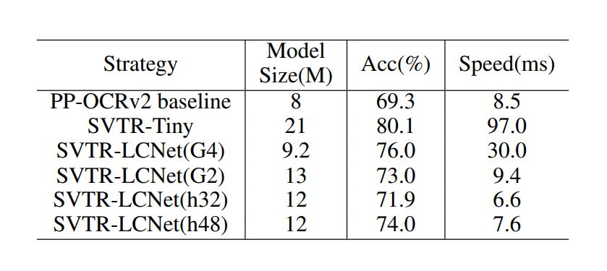
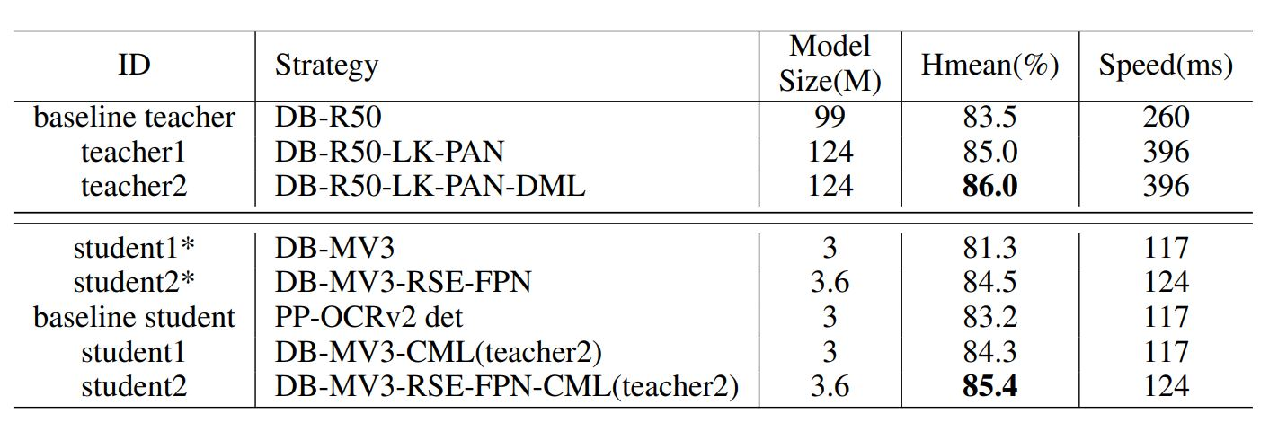
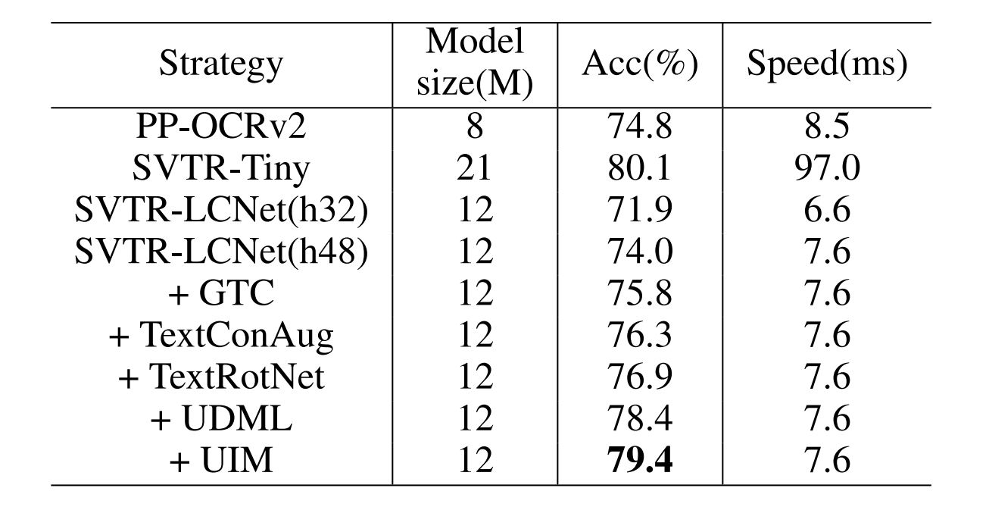
Evaluation
Table 2
Table 1
Table 3

Slide 6
critical analysis
01
Excellence
03
No VISION
02
GIVING CREDIT

Slide 7
Thank you
Reference
Li, C., Liu, W., Guo, R., Yin, X., Jiang, K., Du, Y., ... & Ma, Y. (2022). PP-OCRv3: More Attempts for the Improvement of Ultra Lightweight OCR System. arXiv preprint arXiv:2206.03001.

